Slide 1
DBMS-UNIT 1
Introduction
Notes:
Data is a collection of facts, while information puts those facts into context. While data is raw and unorganized, information is organized.
Data Ex: Each student's test score is one piece of data.
Information ex: The average score of a class or of the entire school is information that can be derived from the given data
The history of temperature readings all over the world for the past 100 years is data. If this data is organized and analyzed to find that global temperature is rising, then that is information.
In computing, data is information that has been translated into a form that is efficient for movement or processing.

Slide 2
Database
By data, it means known facts that can be recorded and that have implicit meaning.
A database is a collection of related data .
For example, consider the names, telephone numbers, and addresses of the people you know. You may have recorded this data in an indexed address book, or you may have stored it on a diskette, using a personal computer and software such as DBASE IV or V, Microsoft ACCESS, or EXCEL.
This is a collection of related data with an implicit meaning and hence is a database.
Notes:
A database can be of any size and of varying complexity. For example, the list of names and addresses referred to earlier may consist of only a few hundred records, each with a simple structure. On the other hand, the card catalog of a large library may contain half a million cards stored under different categories—by primary author’s last name, by subject, by book title—with each category organized in alphabetic order

Slide 3
Database management system
A database management system (DBMS) is a collection of programs that enables users to create and maintain a database. The DBMS is hence a general-purpose software system that facilitates the processes of defining, constructing, and manipulating databases for various applications. Defining a database involves specifying the data types, structures, and constraints for the data to be stored in the database. Constructing the database is the process of storing the data itself on some storage medium that is controlled by the DBMS. Manipulating a database includes such functions as querying the database to retrieve specific data, updating the database to reflect changes in the miniworld, and generating reports from the data.
Notes:
The primary goal of a DBMS is to provide a way to store and retrieve database information that is both convenient and efficient.

Slide 4
DBMS allows users the following tasks:
Data Definition: It is used for creation, modification, and removal of definition that defines the organization of data in the database.
Data Updation: It is used for the insertion, modification, and deletion of the actual data in the database.
Data Retrieval: It is used to retrieve the data from the database which can be used by applications for various purposes.
User Administration: It is used for registering and monitoring users, maintain data integrity, enforcing data security, dealing with concurrency control, monitoring performance and recovering information corrupted by unexpected failure.

Slide 5
Database Systems versus File Systems
One way to keep the information on a computer is to store it in operating system files.
To allow users to manipulate the information, the system has a number of application programs that manipulate the files.
Keeping organizational information in a file-processing system has a number of major disadvantages like Data redundancy and inconsistency, Difficulty in accessing data, Atomicity problems, Security problems etc
Notes:
1]various copies of the same data may no longer agree. For example, a changed customer address may be reflected in savings-account records but not elsewhere in the system
2]The point here is that conventional file-processing environments do not allow needed data to be retrieved in a convenient and efficient manner.
3] It is difficult to ensure atomicity in a conventional file-processing system.
4] Not every user of the database system should be able to
access all the data.

Slide 6
Need of DBMS
DBMS is useful in the following ways:
1. Ease of Accessing Data
In the file system, different files are created for each user containing which data they can access. Also, in the file system, for the user to extract data, there is a need for code or application. DBMS removes redundancy by granting access to users and decides which and how many parts of data is accessible to them from the database. Users can get easy access to data and can also specify the type of data they want to extract.
2. Storage and Management of Data
Data cannot be stored in the form of objects in the file system. The data in the practical world is generally stored in the form of objects and not files. So, an application is required to map the data into objects for further usage. In DBMS, the data can be directly stored in the form of objects.
Notes:
1]Ex: in IRCTC, if we are looking for certain train information( that is 1 kb of data) then with file processing system we will get a file containing entire train information as retrieval results which may be in GB’s. So this is not required as it requires unnecessarily system’s memory. While if we use DBMS then it allows us to query and get required 1 kb data only. So DBMS makes my searching faster and memory utilization more efficient. Also in case of file system, if you want to access data you must be aware of its metadata(data about data) that is file attributes like its location where it has been stored, its permissions etc but in case of DBMS use is not required to have knowledge of these things for accessing data. Through simple query processing system it can get access to required data

Slide 7
Need of DBMS
3. Easy and Efficient File Management
In the file system, the entire database runs for every query operation as files are indexed. It takes a lot of time compared to DBMS, where objects are indexed based on the attribute of data. The complex management of memory becomes easy to handle. With this, retrieval of data is faster than the traditional file system.
4. Avoiding duplicates and Redundancy
Data normalization is used in DBMS to avoid duplicate data.
5. Concurrent Data Accessing
Users can access data simultaneously through different applications. In the file system, this simultaneous access leads to inconsistency. DBMS uses the ACID approach to tackle the issue.
Notes:
The ACID properties, in totality, provide a mechanism to ensure the correctness and consistency of a database in a way such that each transaction is a group of operations that acts as a single unit, produces consistent results, acts in isolation from other operations, and updates that it makes are durably stored.

Slide 8
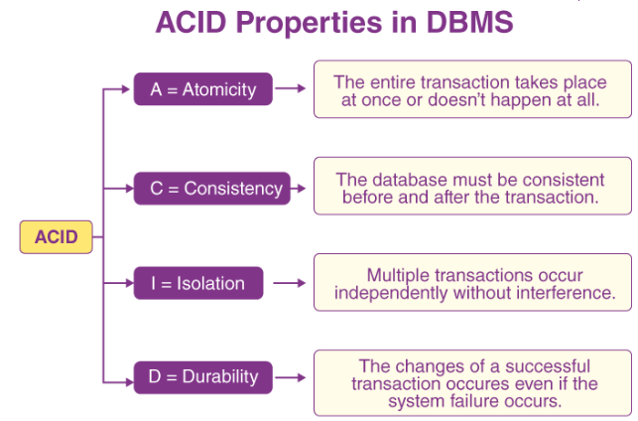
Notes:
Atomicity:
By this, we mean that either the entire transaction takes place at once or doesn’t happen at all. There is no midway . It involves the following two operations.
—Abort: If a transaction aborts, changes made to the database are not visible.
—Commit: If a transaction commits, changes made are visible.
Atomicity is also known as the ‘All or nothing rule’.
The term 'isolation' means separation. In DBMS, Isolation is the property of a database where no data should affect the other one and may occur concurrently. Any changes that occur in any particular transaction will not be seen by other transactions until the change is not committed in the memory. Example: If two operations are concurrently running on two different accounts, then the value of both accounts should not get affected. The value should remain persistent.
. Database Integrity
Any data stored in the database needs to satisfy integrity constraints. For example, a database contains designations of various employees at a company say HR, account specialist, engineer, analyst, project manager, etc. T

Slide 9
Advantages of DBMS
Controls database redundancy: It can control data redundancy because it stores all the data in one single database file and that recorded data is placed in the database.
Data sharing: In DBMS, the authorized users of an organization can share the data among multiple users.
Easily Maintenance: It can be easily maintainable due to the centralized nature of the database system.
Reduce time: It reduces development time and maintenance need.
Backup: It provides backup and recovery subsystems which create automatic backup of data from hardware and software failures and restores the data if required.
multiple user interface: It provides different types of user interfaces like graphical user interfaces, application program interfaces etc
Notes:
Disadvantages of DBMS
Cost of Hardware and Software : It requires a high speed of data processor and large memory size to run DBMS software.
Size: It occupies a large space of disks and large memory to run them efficiently.
Complexity: Database system creates additional complexity and requirements.
Higher impact of failure: Failure is highly impacted the database because in most of the organization, all the data stored in a single database and if the database is damaged due to electric failure or database corruption then the data may be lost forever.

Slide 10
Database System Applications
Banking: For customer information, accounts, and loans, and banking transactions.
Airlines: For reservations and schedule information. Airlines were among the first to use databases in a geographically distributed manner—terminals situated around the world accessed the central database system through phone lines and other data networks.
Universities: For student information, course registrations, and grades.
Telecommunication: For keeping records of calls made, generating monthly bills, maintaining balances on prepaid calling cards, and storing information about the communication networks.

Slide 11
Database System Applications cntd..
Finance: For storing information about holdings, sales, and purchases of financial instruments such as stocks and bonds.
Sales: For customer, product, and purchase information.
Manufacturing: For management of supply chain and for tracking production of items in factories, inventories of items in warehouses/stores, and orders for items.
Human resources: For information about employees, salaries, payroll taxes and benefits, and for generation of paychecks

Slide 12
Data Abstraction
For the system to be usable, it must retrieve data efficiently. The need for efficiency has led designers to use complex data structures to represent data in the database.
Since many database-systems users are not computer trained, developers hide the complexity from users through several levels of abstraction, to simplify users’ interactions with the system;
Physical level
Logical Level
View Level
Notes:
Data abstraction is used to achieve data independence means data and user should be act as 2 different entities. As users are just interested in data contents and not in the actual complex structure about storage of the data so through the data abstraction we are hiding it
Example:Gmail

Slide 13
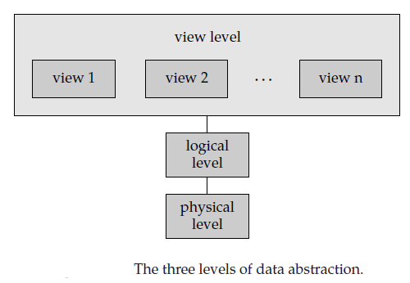
Notes:
View level- it means how the data should be visible to the user or the way in which you present the data to the user. Ex: University database users and their views.
Conceptual Level- It determines what data need to be stored and what are different relationships exists between data.
Physical level- here it includes design specifications of stored database contents like physical storage structure, indexes, locations etc

Slide 14
Physical level. The lowest level of abstraction describes how the data are actually stored. The physical level describes complex low-level data structures in detail.
Logical level. The next-higher level of abstraction describes what data are stored in the database, and what relationships exist among those data.
Database administrators, who must decide what information to keep in the database, use the logical level of abstraction.
View level. The highest level of abstraction describes only part of the entire database. The view level of abstraction exists to simplify users interaction with the system. The system may provide many views for the same database.
Notes:
physical design phase, during which the internal storage structures, access paths, and file organizations for the database files are specified. In parallel with these activities, application programs are designed and implemented as database transactions corresponding to the high-level transaction specifications

Slide 15
DBMS Terminologies
Data Independence
It is defined as a property of DBMS that helps you to change the Database schema at one level of a database system without requiring to change the schema at the next higher level. Data independence helps you to keep data separated from all programs that make use of it.
Instance/database state or snapshot
Databases change over time as information is inserted and deleted. The collection of information stored in the database at a particular moment is called an instance of the database.
Schema
The overall design of the database is called the database schema.

Slide 16
DBMS Architecture
Types of DBMS Architecture:
1- Tier Architecture
2- Tier Architecture
3- Tier Architecture
1- Tier Architecture:
In One- Tier Architecture the database is directly available to the user, the user can directly sit on the DBMS and use it i.e.; the client, server and the Database all present on the same machine. For Example- To learn SQL we setup SQL server and the database on the local system.
Notes:
Korth – page no 685

Slide 17
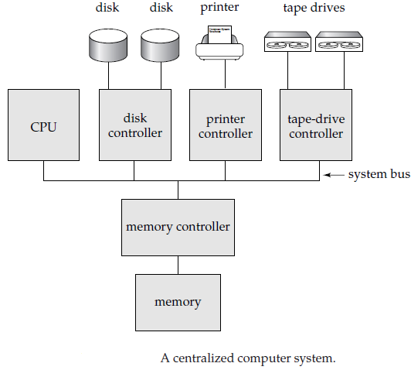
Sometimes it may be referred as Centralized system with single user system.

Slide 18
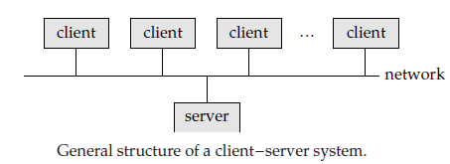
Two-tier architecture:
The two-tier architecture is similar to a basic client-server model. The application at the client end directly communicates with the database at the server-side. APIs like ODBC, JDBC are used for this interaction. The server side is responsible for providing query processing and transaction management functionalities. On the client-side, the user interfaces and application programs are run. The application on the client-side establishes a connection with the server-side in order to communicate with the DBMS. An advantage of this type is that maintenance and understanding are easier, compatible with existing systems. However, this model gives poor performance when there are a large number of users.
Notes:
An application program interface (API) is code that allows two software programs to communicate with each other. An API defines the correct way for a developer to request services from an operating system (OS) or other application, and expose data within different contexts and across multiple channels.
PaaS The platform as a service computing model gives organizations the power to develop software without needing to maintain the backend environment. AWS Elastic Beanstalk, Windows Azure, Heroku, Force.com, Google App Engine, Apache Stratos, OpenShift
IaaS DigitalOcean, Linode, Rackspace, Amazon Web Services (AWS), Cisco Metapod, Microsoft Azure, Google Compute Engine (GCE)
In 2 tier limited clients are there so maintenance is easy but scalability it can’t provide as it can not be made available 24*7 for all clients.
A standard called Open Database Connectivity (ODBC) provides an application programming interface (API), which allows client-side programs to call the DBMS, as long as both client and server machines have the necessary software installed. Most DBMS vendors provide ODBC drivers for their systems. A client program can actually connect to several RDBMSs and send query and transaction requests using the ODBC API, which are then processed at the server sites. Any query results are sent back to the client program, which can process and display the results as needed. A related standard for the Java programming language, called JDBC, has also been defined. This allows Java client programs to access one or more DBMSs through a standard interface

Slide 19
Three Tier architecture: In this type, there is another layer between the client and the server. The client does not directly communicate with the server. Instead, it interacts with an application server which further communicates with the database system and then the query processing and transaction management takes place. This intermediate layer acts as a medium for the exchange of partially processed data between server and client. This type of architecture is used in the case of large web applications.
Advantages: Enhanced scalability due to distributed deployment of application servers. Now, individual connections need not be made between client and server.
Data Integrity is maintained. Since there is a middle layer between client and server, data corruption can be avoided/removed.
Security is improved. This type of model prevents direct interaction of the client with the server thereby reducing access to unauthorized data.
Notes:
An application server is a modern form of platform middleware.
Examples of application server : JBoss: Open-source server from JBoss community. Glassfish: Provided by Sun Microsystem.
Disadvantages: Increased complexity of implementation and communication. It becomes difficult for this sort of interaction to take place due to the presence of middle layers.

Slide 20
Server System Architectures
Server systems can be broadly categorized as transaction servers and data servers.
Transaction-server systems, also called query-server systems, provide an interface to which clients can send requests to perform an action, in response to which they execute the action and send back results to the client. Usually, client machines ship transactions to the server systems, where those transactions are executed, and results are shipped back to clients that are in charge of displaying the data. Requests may be specified by using SQL, or through a specialized application program interface.

Slide 21
Server System Architectures cntd..
Data-server systems allow clients to interact with the servers by making requests to read or update data, in units such as files or pages. For example, file servers provide a file-system interface where clients can create, update, read, and delete files. Data servers for database systems offer much more functionality; they support units of data—such as pages, tuples, or objects—that are smaller than a file. They provide indexing facilities for data, and provide transaction facilities so that the data are never left in an inconsistent state if a client machine or process fails.
Notes:
Data-server systems are used in local-area networks, where there is a high-speed
connection between the clients and the server, the client machines are comparable in
processing power to the server machine, and the tasks to be executed are computation
intensive. In such an environment, it makes sense to ship data to client machines,
to perform all processing at the client machine (which may take a while), and then
to ship the data back to the server machine. Note that this architecture requires full
back-end functionality at the clients. Data-server architectures have been particularly
popular in object-oriented database systems

Slide 22
Classification of Database Management Systems
Several criteria can be used to classify DBMS.
Classification Based on Data Model Relational data model
Object Oriented data model
Classification Based on User Numbers Single user system
Multi User system
Classification Based on Database Distribution
Centralized Distributed Homogeneous
Heterogeneous
Notes:
Relational database example: MYSQL, Oracle etc
Object Oriented data model is a database management system in which information is represented in the form of objects as used in object-oriented programming.
Object oriented model examples: O2, Jasmine,Object store
Homogeneous distributed database systems use the same DBMS software from multiple sites. Data exchange between these various sites can be handled easily.
In a heterogeneous distributed database system, different sites might use different DBMS software, but there is additional common software to support data exchange between these sites

Slide 23
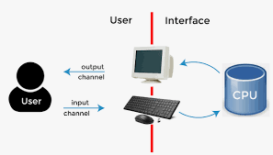
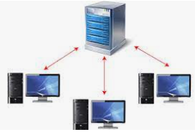
Single User system
Multi User system
Notes:
A typical single-user system is a desktop unit used by a single person, usually with only one CPU and one or two hard disks, and usually only one person using the machine at a time.
A typical multiuser system, on the other hand, has more disks and more memory, may have multiple CPUs and has a multiuser operating system. It serves a large number of users who are connected to the system via terminals.

Slide 24
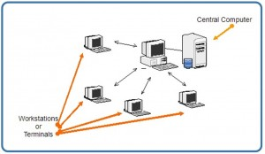
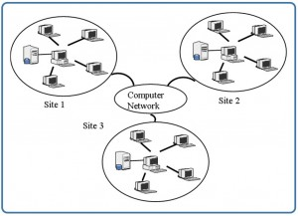
Centralized System
Distributed System

Slide 25
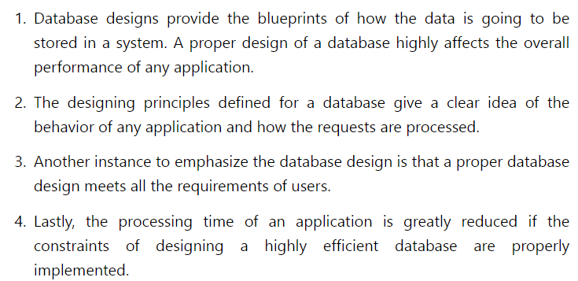
Why is Database Design important?

Slide 26
The Database Design Process
Database Design:
Database design can be generally defined as a collection of tasks or processes that enhance the designing, development, implementation, and maintenance of enterprise data management system
It simply means mapping of conceptual model to implementation model.
Phase 1: Requirements Collection and Analysis
Phase 2: Conceptual Database Design
Phase 3: Choice of a DBMS
Phase 4: Data Model Mapping (Logical Database Design)
Phase 5: Physical Database Design
Phase 6: Database System Implementation and Tuning
Notes:
Navathe page no 471
Why is Database Design:
Database design can be generally defined as a collection of tasks or processes that enhance the designing, development, implementation, and maintenance of enterprise data management system
It simply means mapping of conceptual model to implementation model.
The goals of database design are multiple:
• Satisfy the information content requirements of the specified users and applications.
• Provide a natural and easy-to-understand structuring of the information.
• Support processing requirements and any performance objectives such as response time, processing time, and storage space.

Slide 27
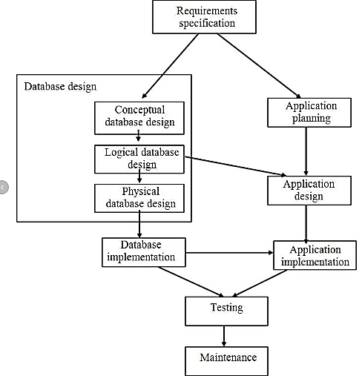

Slide 28
Phases of Database Design (contd.)
Requirements Collections and Analysis
Identifying Users
Interacting with users to gather requirements
Time consuming BUT very important
Conceptual Database Design
Produce a conceptual schema for the database that is independent of a specific DBMS
Involves two parallel activities
Conceptual Schema Design
Transaction and Application Design

Slide 29
Approaches to Conceptual Schema Design
Centralized Schema Design Approach
Also known as one-shot approach
Requirements of different applications and user groups are merged into a single set of requirements and a single schema is designed
Time consuming, places the burden on DBA to reconcile conflicts
View Integration Approach
Schema is designed for each user group or application
These schemas are then merged into a global conceptual schema during the view integration phase
More practical

Slide 30
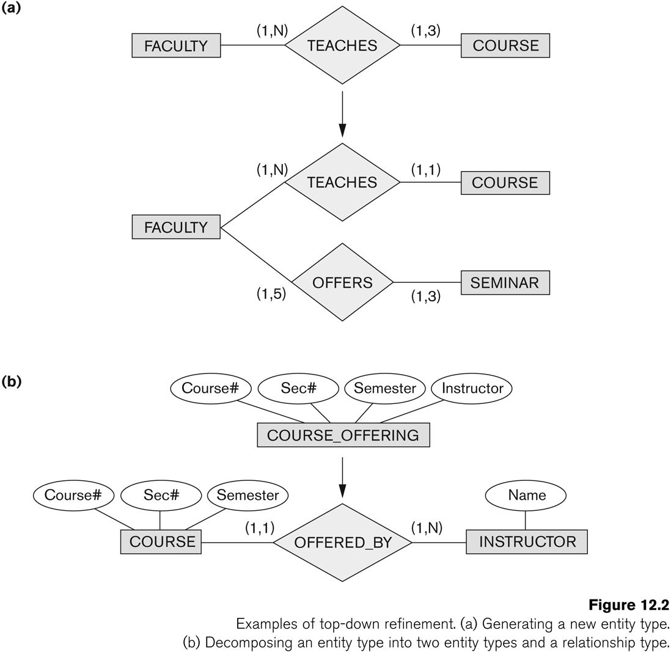
Strategies for Schema Design
Top Down Strategy
Start with a schema containing high-level abstractions and then apply successive top-down refinements

Slide 31
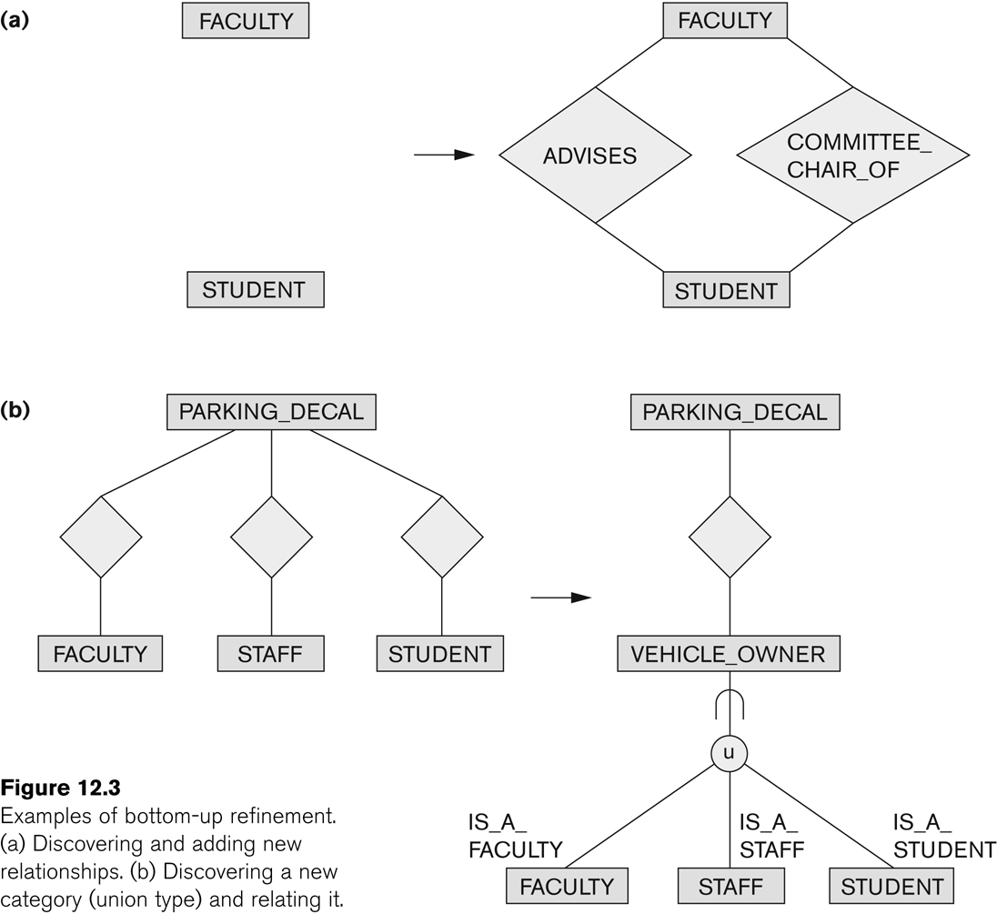
Strategies for Schema Design (contd.)
Bottom-Up Strategy
Start with a schema containing basics abstractions and then combine or add to these abstractions

Slide 32
Strategies for Schema Design (contd.)
Inside-out Strategy
Start with central set of concepts and then spread outward by considering new concepts in the vicinity of existing ones
Mixed Strategy
Use a combination of top-down and bottom-up strategies

Slide 33
Phases of Database Design
Many factors to consider for Choice of DBMS(Phase 3)
Technical Factors
Type of DBMS: Relational, object-relational, object etc.
Storage Structures
Architectural options
Economic Factors
Acquisition, maintenance, training and operating costs
Database creation and conversion cost
Organizational Factors
Organizational philosophy
Relational or Object Oriented
Vendor Preference
Familiarity of staff with the system
Availability of vendor services

Slide 34
Phases of Database Design (contd.)
Data model mapping (Phase 4): During this phase, which is also called logical database design, we map (or transform) the conceptual schema from the high-level data model used in Phase 2 into the data model of the chosen DBMS. We can start this phase after choosing a specific type of DBMS—for example, if we decide to use some relational DBMS but have not yet decided on which particular one. We call the latter system-independent (but data model-dependent) logical design.

Slide 35
Phases of Database Design (contd.)
Physical database design (Phase 5): During this phase, we design the specifications for the stored database in terms of physical storage structures, record placement, and indexes. This corresponds to designing the internal schema in the terminology of the three-level DBMS architecture.

Slide 36
Phases of Database Design (contd.)
Database system implementation and tuning (Phase 6): During this phase, the database and application programs are implemented, tested, and eventually deployed for service. Various transactions and applications are tested individually and then in conjunction with each other. This typically reveals opportunities for physical design changes, data indexing, reorganization, and different placement of data—an activity referred to as database tuning. Tuning is an ongoing activity—a part of system maintenance that continues for the life cycle of a database as long as the database and applications keep evolving and performance problems are detected.

